Slide 1
BLOG MANAGEMENT SYSTEM
Under The Guidance of:
Pooja Mehta
Submitted by:
Nikita Ghansawant

Slide 2
Introduction
The Blog Management System Project has been developed on AngularJS, NodeJS and Mysql. We are providing angularjs projects with source code, database, and documentation. This application is very simple and impressive.
The main objective behind this angularjs application Blog Management System is to provide simple blog system to share the information and thoughts on many topics. There is a role user that is admin in this project who can only post the blog. User can read the blog ,like or dislike the blog, comment on the blog .
In this project only Admin can update or delete the blog which admin created himself.

Slide 3
Project Objective
Our application's primary purpose is to offer a user-friendly platform for customers to post and read blogs, with a focus on user convenience and accessibility to blogs of various topics such as sports, politics, and jobs.
This Java Online Blog Management System features an online interface where users can easily view, read, like, dislike, and comment on blogs. Users can register as either a regular user or an admin, with only admins having the privilege to post blogs.
Admins can effortlessly post blogs of their choice, and to do so, users must first register as an admin within the system. Once registered, they can contribute their own blogs on specific topics of interest.
Our application aims to create an interactive blog-sharing community, allowing users to engage with content that matters to them while also providing an efficient and user-centric experience for both readers and bloggers.

Slide 4
TECHNOLOGY USED
JAVA
Java is an object-oriented programming (OOP) language, which means it supports the principles and concepts of object-oriented programming.
HTML
angular
HTML, which stands for HyperText Markup Language, is the standard markup language used for creating and structuring web pages.
ANGULAR
Angular is a TypeScript-based framework that uses HTML, CSS, and JavaScript to build robust and scalable single-page applications.
POSTMAN
JAVASCRIPT
Postman is a popular collaboration platform and toolset used by developers to build, test, and document APIs
JavaScript is a widely used programming language primarily used for web development.

Slide 5
PROPOSED SYSTEM
Blogging platforms serve as user-friendly broadcast-style communication systems for authors to publish posts, enabling easy access to information for readers.
A comprehensive full-stack project utilizes Java Spring Boot, Hibernate, MySQL, and Angular to address modern web development challenges. Spring Boot offers rapid backend development, Hibernate ensures seamless database communication, and Angular creates dynamic user interfaces.
Leveraging these technologies results in a robust, scalable, and user-friendly application that meets the demands of contemporary web development.

Slide 6
REQUIRED SPECIFICATIONS
HARDWARE CONFIGURATION | SOFTWARE CONFIGURATION
Operating System : Windows 10 and above | Software IDE: Eclipse, Postman, MySQL, VS Code.
Hard Disk: 500 GB | Language: JAVA, Type Script, HTML, CSS
RAM: 8 GB | Front End: Angular, Boot Strap
 | Back End: Spring Boot, MySQL.

Slide 7
MODULES
Admin- Login and Manage.
User-Signup and Login.
Create blog- Create/ Update the blog by admin.
Blog List- User read the blog.
Comment-User comment in blog and like, dislike.

Slide 8
SPRING NOTATATIONS
@Controller : | The @Controller annotation indicates that a particular class serves the role of a controller. Spring Controller annotation is typically used in combination with annotated handler methods based on the @RequestMapping annotation.
@Autowired | The @Autowired annotation provides more fine-grained control over where and how auto-wiring should be accomplished. Autowiring feature of spring framework enables you to inject the object dependency implicitly. It internally uses setter or constructor injection.
@RequestMapping | The @RequestMapping is one of the most common annotation used in Spring Web applications. This annotation maps HTTP requests to handler methods of MVC and REST controllers.
@Entity | The @Entity annotation specifies that the class is an entity and is mapped to a database table.
@Table | The @Table annotation is used to create a table in database.
@JoinColumn | The @JoinColumn is used to specify a column for joining an entity association or element collection.

Slide 9
SPRING NOTATATIONS
@PutMapping | The @PutMapping is used for update the records.
@PostMapping | The @PostMapping is used to create a resource Mapping.
@GetMapping | The @GetMapping is used to read all the inserted records.
@DeleteMapping | The @DeleteMapping is used to delete the records.
@PathVariable | The @Path Variable annotation is used to extract the value from the URL.
@RequestParam | The @RequestParam annotation is used to read the form data and bind it automatically to the parameter present in the provided method.

Slide 10
SPRING NOTATATIONS
@Request Body | The @RequestBody annotation is applicable to handler methods of spring controller. spring should deserialize a request body into an object.
@OneToOne Mapping | The @OneToOne JPA annotation is used to map the source entity with the target entity, Hibernate maps the tables in your database to the Entity classes in your application.
@OneToMany Mapping | The @OneTo-Many relationship between table A and table B indicates that one row in a table A link to many rows in table B but one row in table B links to only one row in table A.
@ManyToOne Mapping | The @Many-to-One mapping means that many instances of this entity are mapped to one instance of another entity.
@ExceptionHandler | The @ExceptionHandler is an annotation used to handle the specific exceptions and sending the custom responses to the client.
@ControllerAdvice | A controller advice allows you to use exactly the same exception handling techniques but apply them across the whole application, not just to an individual controller. You can think of them as an annotation driven interceptor.

Slide 11
CONCLUSION
In summary, a blog management system developed using Java, SQL, Angular, and Spring combines the power of back-end development, database management, front-end interactivity, and framework support to create a comprehensive and efficient solution. It enables the seamless management of blog content, enhances user experience, and provides necessary administrative tools for efficient system maintenance.
Blogger is a service for self-expression and communication. We believe Blogger increases the availability of information, encourages healthy debate, and makes possible new connections between people. It is our belief that censoring this content is contrary to a service that bases itself on freedom of expression.

Slide 12
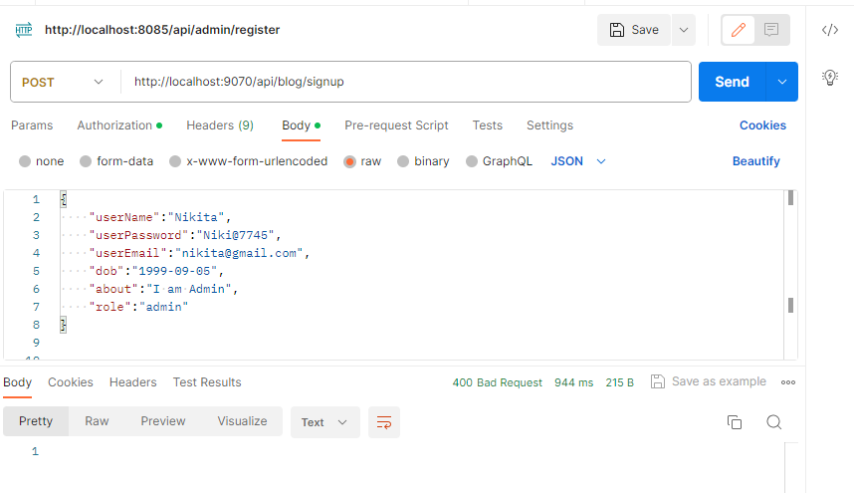
Admin Registration From Postman

Slide 13
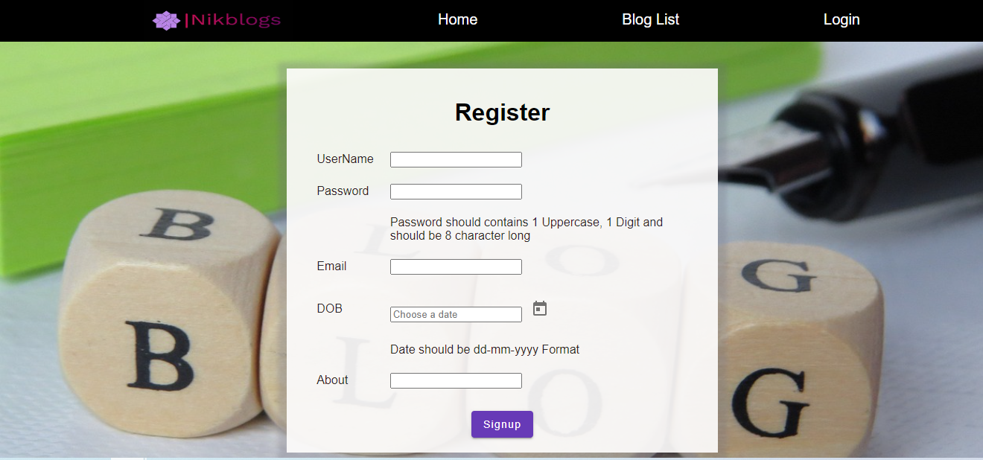
User Registration

Slide 14
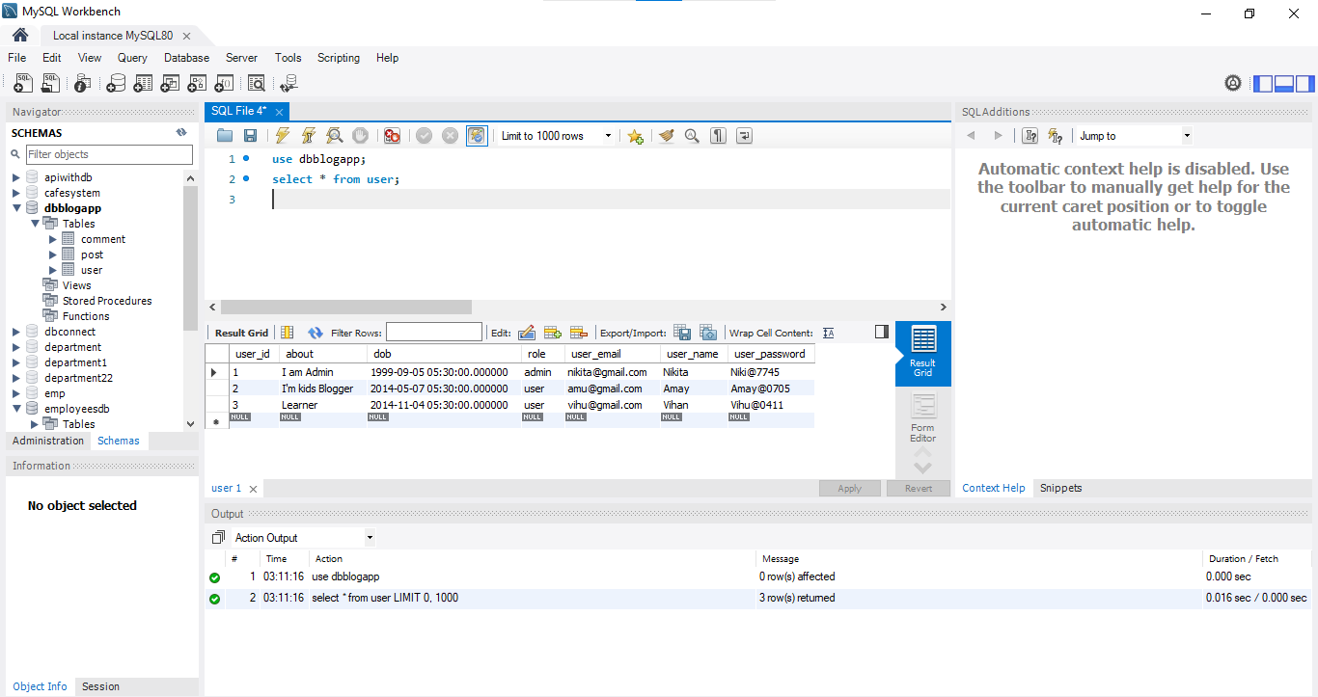
User Table

Slide 15
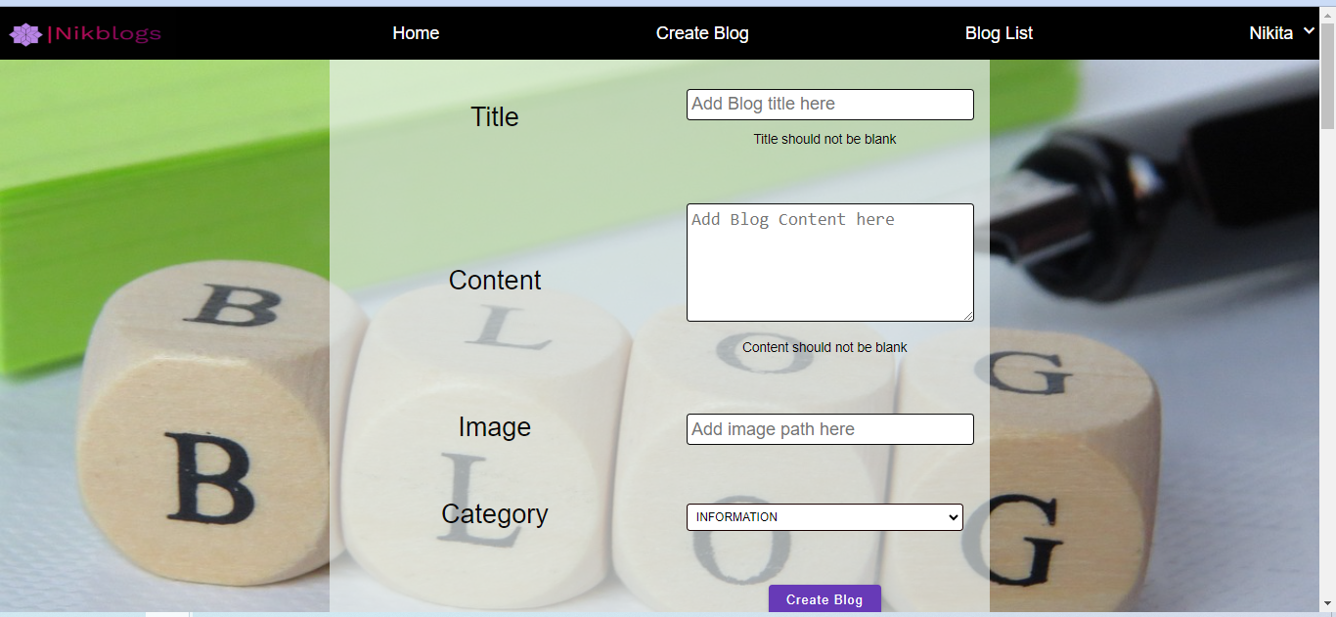
Create Blog From Admin

Slide 16
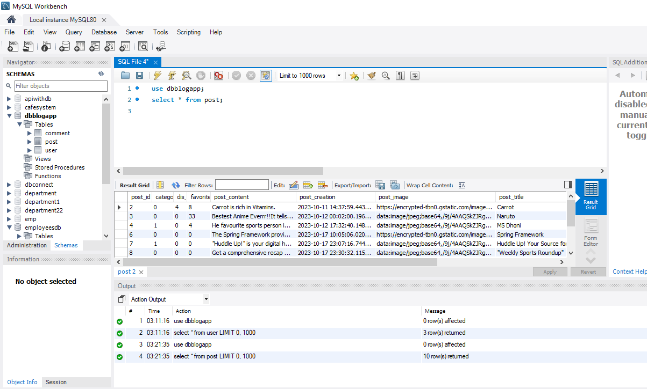
Blog Post Table

Slide 17
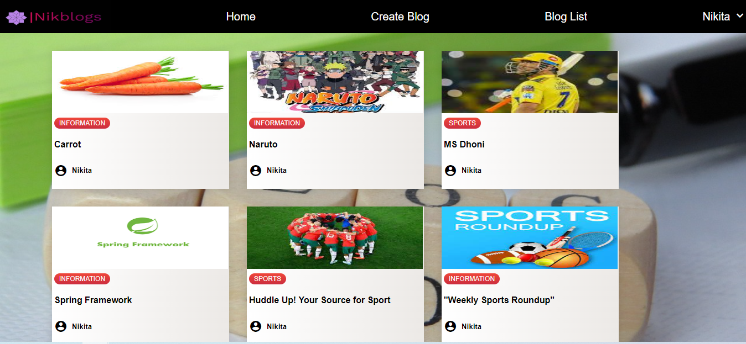
Blog List

Slide 18
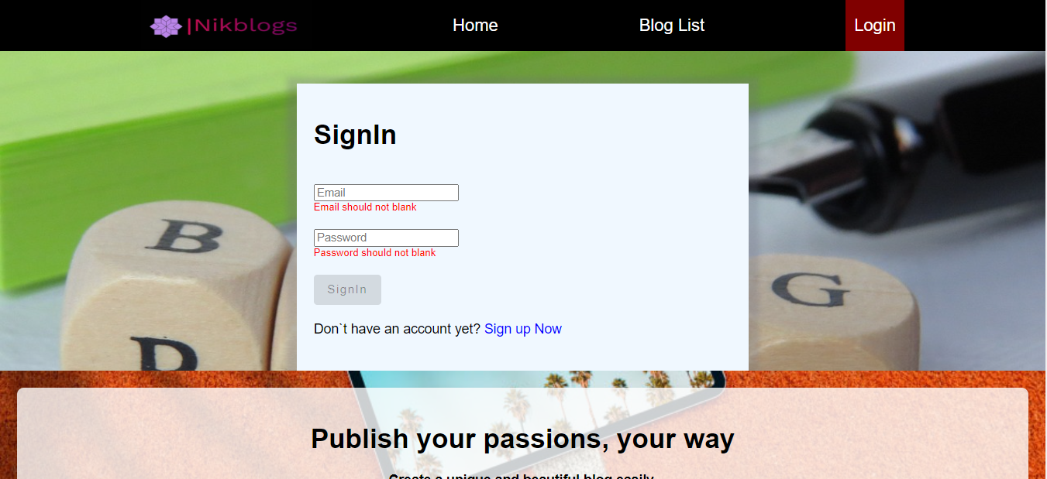
User Sign-in

Slide 19
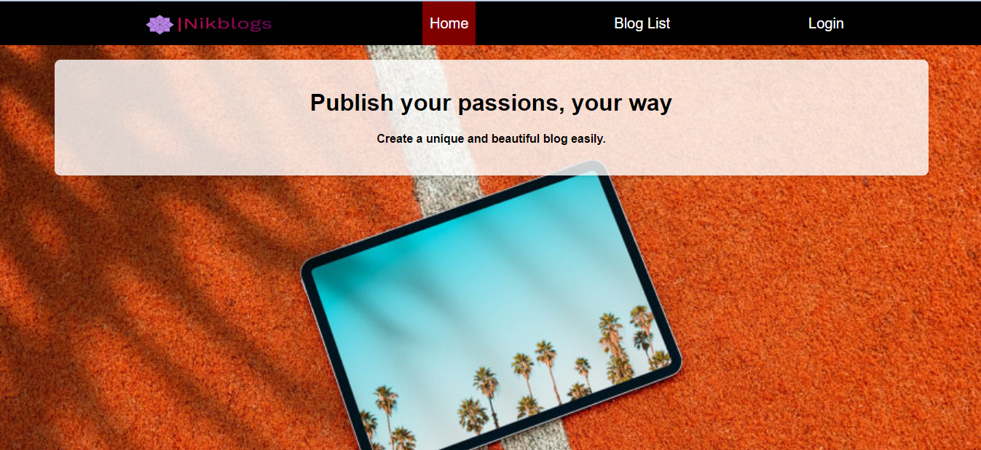
Home Page

Slide 20
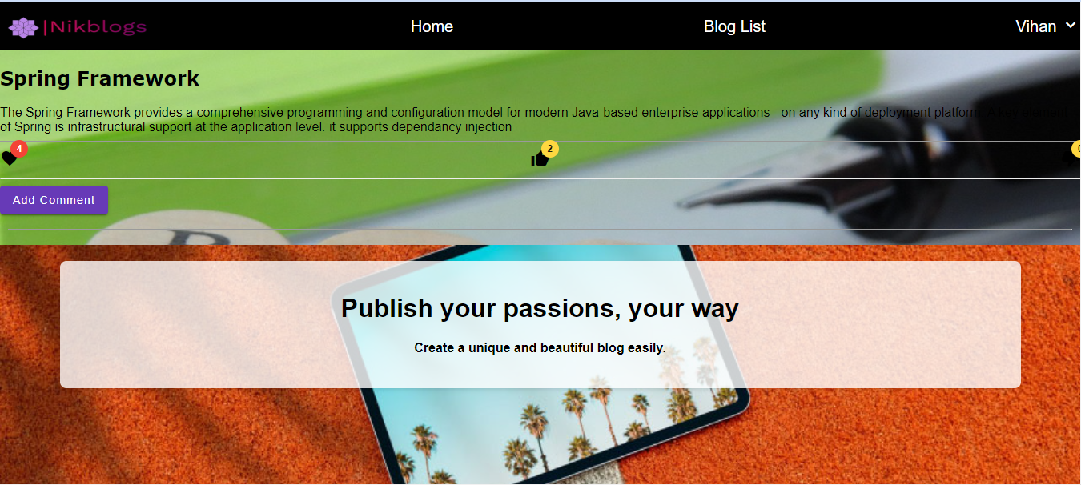
Blog Content

Slide 21
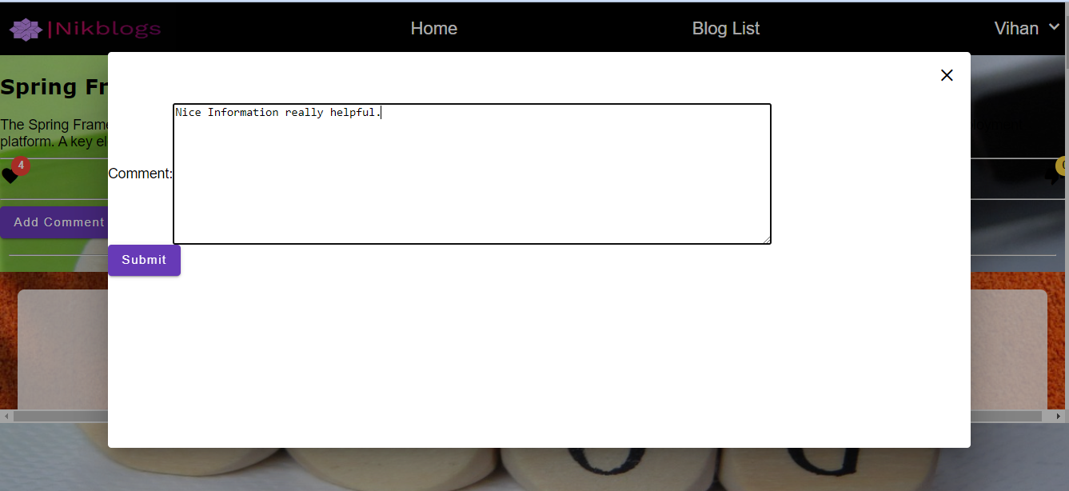
Add Comment

Slide 22
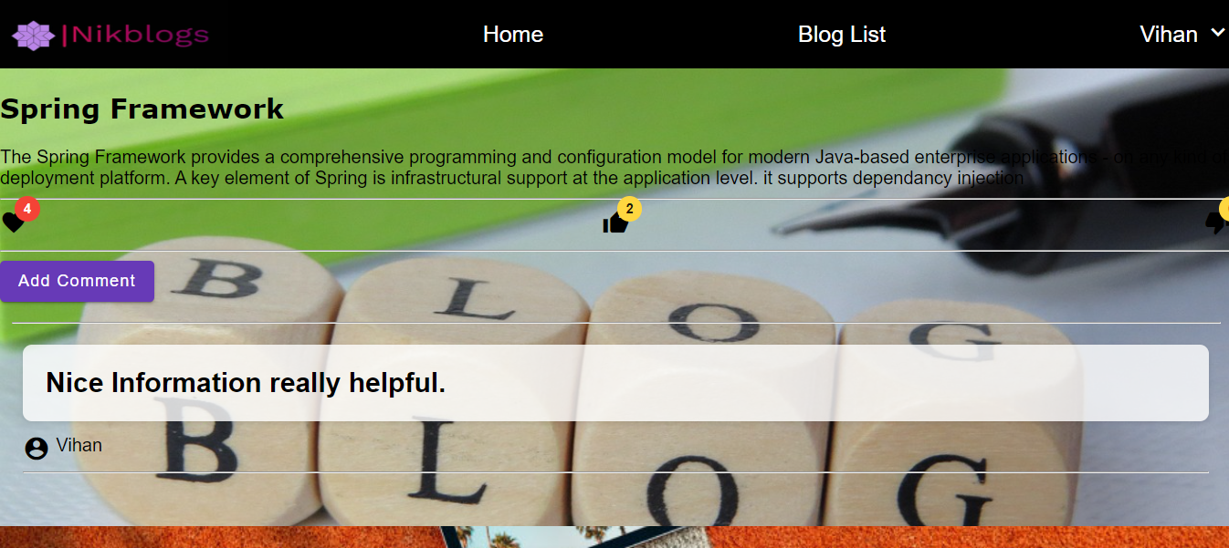
View Comment

Slide 23
THANK YOU

